Slide 1
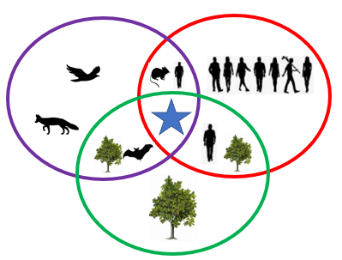
Outbreak:
One World - One Health
© 2022 Deborah Thomson
All Rights Reserved.
Notes:
This lesson addresses:
U.S. Next Generation Science Standards: (these are addressed throughout the lesson but highlighted slides are listed)
NGSS Standards: Grade 3: LS: Interdependent Relationships & Ecosystems (slides 8-13)
NGSS Standards: Grade 6: ESS3.C: Human Impacts on Earth Systems (slides 8-13)
United Nations Sustainable Development Goals: (these are addressed throughout the lesson but highlighted slides are listed)
Good Health and Well-being (slide 30)
Quality Education (slides 1-33)
Clean Water and Sanitation (slides 8-10)
Affordable and Clean Energy (slides 11-13- deforestation)
Sustainable Cities and Communities (slides 11-13- deforestation)
Responsible Consumption and Production (slides 8-13- deforestation)
Climate Action (slides 9-11)
Life on Land (slides 8-10)
Partnerships for the Goals (slides 3, 7, 29, 30 and 31)
Overview:
Have you ever thought about how disease outbreaks start? A germ finds the ideal environment and runs out of control! The germ may jump between species and onto you. How can we prevent this? How can we protect ourselves now and in the future? Find out more with Outbreak: One World - One Health!
Lesson Objectives:
1. Students will understand that the health of people is dependent on the health of animals and the environment (slides 8-33)
2. Students will understand the need for vaccines (slides 7, 30)
3. Students will better understand the importance of protecting our environment (slides 8-14)
4. Students will better understand disease transmission and mutations (slides 17-27)
5. Students will see what health professionals are currently combating (slide 30)
6. Students will understand the importance of good communication between different professions (slides 7 and 30)

Slide 2
We will review:
One Health
Species
Zoonotic disease
Mutation
Vaccine
Notes:
Each keyword has an individual slide with its definition in the following 5 slides

Slide 3
What is
“One Health”?
The connection between:
Animal Health
Human Health
Environmental Health
Notes:
Emphasize here that veterinarians can work closely with (human) doctors and environmental health scientists to efficiently improve the health of the animals, people and the environment at the same time.
Definition from the United States CDC website (https://www.cdc.gov/media/releases/2019/s0506-zoonotic-diseases-shared.html):
One Health is an approach that recognizes the connection between people, animals, plants, and their shared environment and calls for experts in human, animal, and environmental health to work together to achieve the best health outcomes for all.

Slide 4
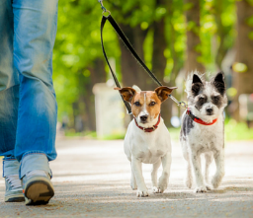
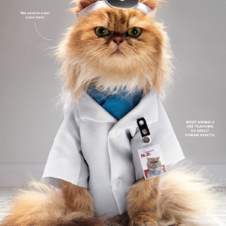
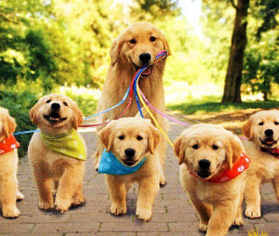
What is a
“Species”?
A group of living things that are similar enough to one another that they can create babies together.
How many species here?
Notes:
(Note: This slide requires slideshow view. If you are not already using this method of review, it is best to start now.)
Ask how many species are in each picture. Note that there are more than 3 species in the top picture because plants have different species.
Tip for teachers:
A good way to explain this slide is:
“Two cats can make kittens and two dogs can make puppies. Can a cat and a dog together have babies? No- because they are different species.”

Slide 5
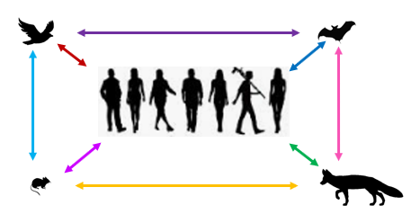
What is a
“Zoonotic Disease”?
A disease
that
jumps
between
different
species.
Examples:
Rabies, (sometimes) Flu
Notes:
Emphasize that these diseases jump to people.
Ask how many species are represented on this slide (answer: 5 because humans are a type of animal species)
Tip for teachers:
Emphasize the “zoo” in zoonotic. Ask how many species are in the zoo? (A lot.) Let’s name some! (Make sure that they say people who are visiting the zoo- drive home the point that human is a type of animal.)

Slide 6
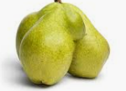
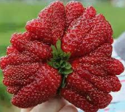
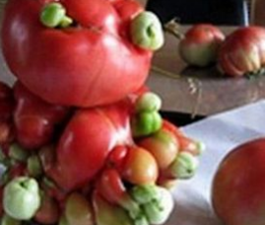
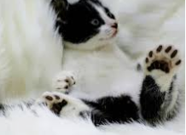
What is a “Mutation”?
A change that affects behavior or development.
Notes:
Emphasize here that viruses and bacteria and parasites and even cells inside people and animals can mutate (ex. some people-like this cat-have an extra toe or two!).
A good tip here is to have all the students repeat the phrase: “Mutation is Change”. This phrase can be repeated throughout the class. (Later on, the students learn that a mutation can strengthen or weaken a virus’ ability to infect a cell and replicate. Sometimes a mutation does not make much of a difference, it is just a benign change. Other times, the difference is important.)

Slide 7
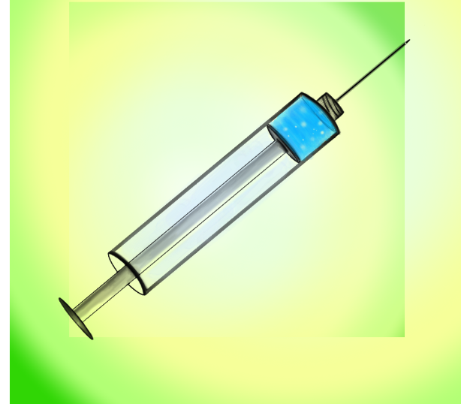
Vaccine
Something that helps a body fight a disease.
(like the flu shot)
Notes:
Vaccines are meant to strengthen a body to fight an upcoming germ. Note that a person (or animal) who gets a vaccine does not become invincible against that particular germ/microbe (which the vaccine is developed to fight). A person or animal can still get sick from the germ but, often, not nearly as sick as a person or animal that never received that vaccine.
Review that:
An important point should be made to avoid confusion: a vaccine is NOT a medication. A vaccine is given BEFORE somebody gets exposed to a germ (ex. virus or bacteria) and a medication (ex. antiviral drug or an antibiotic) is only given AFTER somebody gets sick from that germ.
Both veterinarians and (human) doctors and researchers constantly work together to develop vaccines.
Medications can be developed from plants, microbes and other items found in the environment.
→ Example: Penicillin https://www.kidsdiscover.com/quick-reads/penicillin-found-functional-fungus/
Specialists who work with the environment, people and animals are all working together to make people better protected against diseases. They must communicate efficiently so that they do not waste any time. This is One Health in action!
Tip for teachers: use an example from a veterinarian’s point of view—
A dog that receives a vaccine (ex. the rabies vaccine) will not be as sick from the germ it was designed to fight against (ex. the rabies virus) compared to a dog that does NOT get the vaccine. The same general principal is true for people.
(If the students ask, for the rabies example- the unvaccinated dog would likely die from the disease IF it gets infected by the rabies virus—and the dog could bite people and spread it-because it is a zoonotic disease).

Slide 8

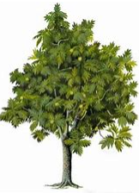

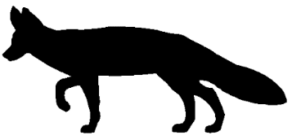

One Health: Part 1-- Environmental health
Notes:
Ask the students: “what are the three parts of One Health?” (Answer: human health, animal health, and environmental health)
Say that this is a picture of a busy and healthy forest. The animals are evenly spread out and there is no stress to any of the animals. The trees look healthy too.
(The teacher can discuss that clean water also plays a role in this forest ecosystem. This slide covers UN Sustainable Development Goals of “Clean Water and Sanitation” and “Life on Land”.)

Slide 9

One Health: Part 2-- Animal health
Notes:
Ask the students:
“Why are there less trees?” (Either from deforestation due to people or because of climate change which makes life for those plants more difficult in that area of the world.)
“Where are the animals going when there are less trees?” (They are starting to crowd together in a smaller area. They are more stressed because they have more competition for food/shelter and have less space to live in. Some animals are even leaving the forest to find food and are now near people).
(The teacher can discuss that water quality also plays a role in this changing ecosystem. If animals drink dirty water that is contaminated by either people or animals then they can get sick. Besides deforestation, the teacher can discuss how Climate Change can alter natural habitats and lead to animals (including insects) move into new territories. This slide would then cover the UN Sustainable Development Goals of “Climate Action”, “Affordable and Clean Energy”, “Sustainable Cities and Communities”, “Responsible Consumption and Production”, “Clean Water and Sanitation” and “Life on Land”.)

Slide 10
One Health: Part 3-- Human health
Notes:
Ask the students:
“What changes do you see with this slide compared to the previous slide?” (there are more people, less trees, more animals near people). Note that there are no actual changes to the number of animals between the slides.
“What is a zoonotic disease?” Review that, in this slide, there are more people in the area where animals have been living. This is an area where zoonotic diseases can easily “spill over” and spread between animals and people.
(The teacher can discuss that water quality also plays a role in this changing ecosystem. If animals drink dirty water that is contaminated by either people or animals then they can get sick. Besides deforestation, the teacher can discuss how Climate Change can alter natural habitats and lead to animals (including insects) move into new territories. This slide would then cover the UN Sustainable Development Goals of “Climate Action”, “Affordable and Clean Energy”, “Sustainable Cities and Communities”, “Responsible Consumption and Production”, “Clean Water and Sanitation” and “Life on Land”.)

Slide 11
One Health
Notes:
Review that the birds are either leaving the smaller forest or they are dying because of the increased competition for food and shelter (trees).
Climate change can further shrink an animal’s habitat and lead to species extinction by changing what plants grow in the area or make the temperature unsuitable for life for that (animal or plant) species. Climate change affects animals, people and plants in this way.
(This slide addresses UN Sustainable Development Goal: “Climate Action”)

Slide 12
One Health
Notes:
Compare and contrast this slide with the previous slide. Slowly go back-and-forth several times.
Ask students if they can name the 5 changes between the two slides. (The answers are in the “notes” section of the next slide.)

Slide 13
What are the five changes in the last picture?
No more birds
Why?
Less trees
Why?
More mice
Why?
More foxes
→Why?
More wild animals in human areas
→ Why?
Notes:
Teacher answers:
No more birds– because too much competition for food and shelter (due to habitat loss)
Less trees– because either people are chopping them down or because some birds are responsible for eating fruits and dispersing seeds and they can serve as pollinators
More mice– because other types of birds eat mice and when there are no longer these birds in the forest, the mouse population increases
More foxes- when the mouse population increases, there are more mice for foxes to eat
More animals in human areas- because the animals have no other choice (their home is gone or it is easier for them to survive/find food near people). Emphasize that this situation can increase the spread of zoonotic diseases.

Slide 14
One Health &
Zoonotic Diseases
Environment is damaged because of people’s actions.
Animals are stressed out! They need to either compete for food in smaller space or leave the forest. They live closer to other animal neighbors (and people). Just like in people, animals can carry germs that do not make them sick.
People are taking up the space where animals were once living. This brings animals closer to people. Sometimes people eat wild animals. Some germs are zoonotic and some viruses can mutate.
Notes:
Review terms zoonotic and mutation (on the next two slides)

Slide 15
Zoonotic Disease
Notes:
Review quickly: This is a disease that can jump between different species and into people.

Slide 16
MUTATION?
Notes:
Review quickly.

Slide 17

Mutations can happen by accident
Mutations can happen inside many things: people, animals, plants, viruses, bacteria, and more.
→Scientists work with MODELS. We will see different ways mutations can happen by using models.
The first activity is seeing a mutation in a….
sentence.
Notes:
Explain that:
A model is like play-pretend. It sometimes helps scientists guess the future so that we can stay healthy (ex. scientists create models that try to guess that ‘x’ amount of people will be sick from a virus, therefore we all need to practice social distancing for ‘y’ amount of time).

Slide 18
Who will NOT mutate the sentence?
Challenge:
Who can say this FIVE times FAST?
A black bug bit a big black bear.
Notes:
Review that “mutation is change”. Ask for 2-3 volunteers to quickly read this bold sentence five times.
This tongue-twister serves as a model for a type of mutation- the simplest kind of mutations called “point mutations”.

Slide 19


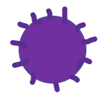
The Mystery Box
Notes:
Explain that another way viruses can mutate is by mixing in an animal (ex. a pig, bat). Review that this “animal” could also be a person!
The first animal example here is a pig. This is because swine flu (an influenza virus) occurred after a pig combined different viruses inside of itself. (A pig can mix bird, human and pig viruses! https://www.ncbi.nlm.nih.gov/pubmed/19565018)
The second animal example here is a bat. Ask the students if a bat is responsible for something like this, what can be done about it? (Some students here say to keep your distance—which is the correct answer-- and other students say to kill the bats. As a response to that second answer, the next slide is presented- saying that bats are VERY important for the ecosystem!)
For the teacher: this slide models a style of mutation called genetic reassortment (and, more specifically, “antigenic shift”). Through “genetic reassortment”, a new virus can be made.

Slide 20
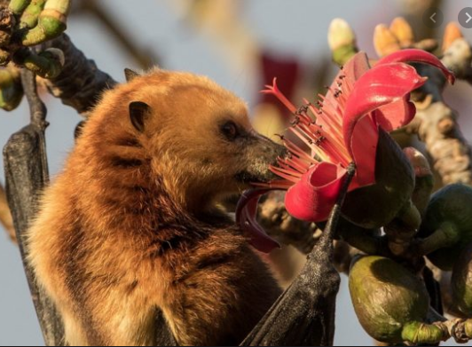
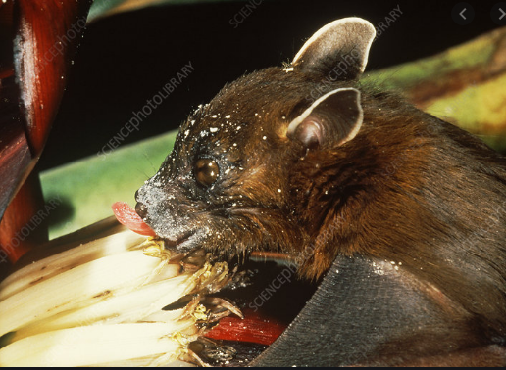
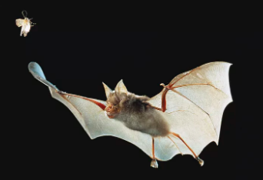
Remember:
Bats are really important!!!
Notes:
In the previous slide, a bat was the second example. Keep in mind bats are very important- they eat insects and they are pollinators and disperse seeds.
For more information on this topic:
General information: https://www.bats.org.uk/about-bats/why-bats-matter
PDF for bats that live in caves (and mentions White-Nose Syndrome): https://www.fs.fed.us/biology/resources/pubs/tes/wns-brochure8310.pdf

Slide 21
Let’s see how two viruses can mutate into one!
With another word competition!
But first here is an example:
Notes:
(This activity models another way a virus can mutate, called genetic reassortment.)

Slide 22
ONCE UPON A TIME…
Once upon a time, there was an extremely ____
_______ that _____ to _____ ______ and _____.
Notes:
This activity models genetic reassortment.
The students will eventually be filling in blanks in a similar sentence. The next slide demonstrates an example of what the students will eventually do themselves.

Slide 23
ONCE UPON A TIME…
Once upon a time, there was an extremely HAPPY
RABBIT that LOVED to EAT CARROTS and BANANAS.
Once upon a time, there was an extremely SNEAKY
LION that ROARED to SCARE FRIENDS and NEIGHBORS.
Notes:
Review that the red sentence is like the red virus. The blue sentence is like the blue virus. What happens when we combine these two sentences together to make a mutated sentence? (see next slide)

Slide 24
ONCE UPON A TIME…
Once upon a time, there was an extremely HAPPY
LION that LOVED to SCARE CARROTS and NEIGHBORS.
Once upon a time, there was an extremely SNEAKY
RABBIT that ROARED to EAT FRIENDS and BANANAS.
Notes:
Review the example of the mutated sentences.

Slide 25
Can you do better?
Can you win the
best awkward sentence mutation contest?
FILL in the one sentence:
Once upon a time, there was a ____that ____ the _____ for _____.
Notes:
Ask the students to use the chat box and write the entire sentence with the blanks filled in (ideally, the new words are written in CAPITAL LETTERS). Have the students submit their entry to “everybody” in the chat.
If the chat box is not possible, then the students can submit answers by speaking.
Tip: The suggested time for students is 3 minutes but this can be adjusted based on the group.

Slide 26
Can you do better?
Can you win the
best awkward sentence mutation contest?
2. Choose second sentence from a friend (in the chat box)
Once upon a time, there was a ____that ____ the _____ for _____.
Notes:
Once everybody has typed the entire sentence with the blanks filled in (ideally, in CAPITAL LETTERS), the teacher can demonstrate how to combine two student sentences together to make a strange mutated sentence.
Ask the students after creating the mutated (combined) sentence, if the mutation strengthened or weakened the original sentences’ messages (or simply made the sentence very strange).
Ask for 1-2 student volunteers to combine other sentences found in the chat box to make a newly mutated sentence.
Review: this sentence activity is another model of how a mutation can happen in a virus or in a cell. Sometimes, mutations change a virus to become stronger or weaker.

Slide 27
Remember:
1) Mutations can happen by accident
2) Viruses can combine to make a new virus
Notes:
Sum up what the two activities demonstrate and relate them back to mutation in viruses.
Review that 1) Mutations can happen by accident like in the tongue-twister activity, and 2) Viruses can combine to make a new virus like in the sentence mutation activity. Mutations can make something weaker, stronger, or just a bit weird.

Slide 28
Any questions?
Let’s pause here and ask you….
Notes:
Give students a chance to ask questions here.

Slide 29
Introducing the One Health Approach
TEAMWORK!
Notes:
Tip: Spend up to 1 minute on this slide.
The One Health approach: teamwork between people of different backgrounds, strengths and disciplines to prevent and solve complicated health problems.
Ask: what other types of people are important to fix big health problems like the loss of biodiversity?
(Any of the student answers will be correct. Here are some answers and the reasons for them:)
Physicians (human doctors)- they treat sick people
Veterinarians- they understand germs that can come from animals and spread to people (review the term: zoonotic disease)
Ecologists – they study the interaction between animals and their environment
Sociologists- they understand why people make certain decisions
Politicians- they create laws to protect the environment, people, animals, plants and more
Economists- they help businesses stay open and help livelihoods/income/well being of families
Researchers- they help develop vaccines
Teachers- they help spread awareness and knowledge to protect more people

Slide 30

How can we protect ourselves in the future?
  One Health: Environmental health and Animal health and Human health
  Scientists (human doctors, veterinarians, and other researchers) start working together to prevent zoonotic disease and other outbreaks!
  Stay away from wild animals
  Rebuild the forests and improve the health of the environment
Notes:
Ask: what are the three parts of One Health?
For the first point- Emphasize that people from different backgrounds, disciplines and strengths can work together to prevent and solve health problems that affect people, animals and the environment. This teamwork is often referred to as the One Health approach.
For the second point- Emphasize that people are often taking up the space where wild animals once lived. Because of the smaller natural habitat for animals, they are being forced out of the forest/natural habitat to scavenge for food and survive. Review that people have germs that can spread to animals and animals can have germs that spread to people and other animals.
For the last point- If students think that planting trees is the only way to rebuild a forest, review that decreasing paper usage can lead to less deforestation. If people demand less from the environment, Nature can heal itself with time.
- Example of decreasing paper usage: use a reusable cloth bag when shopping instead of getting a new paper bag each time.

Slide 31
How can the
ONE HEALTH APPROACH prevent outbreaks?
Who is included?
Notes:
Review quickly.

Slide 32
Final activity
Create a short play (or video) that includes the following words:
One Health
Species
Zoonotic disease
Mutation
Vaccine
Notes:
Ask students to create a 1–2-minute play that uses the terminology covered in the lesson. This can be done during the lesson (time-permitting) or as homework.

Slide 33
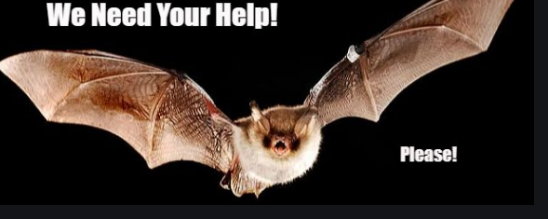
One Health
Notes:
2-minute survey for teacher to complete:
Other One Health online activities for students:
Game for students to better understand microbes and zoonotic diseases:
http://webadventures.rice.edu/ed/Teacher-Resources/_games/MedMyst-Original/_301/Game-Overview.html
Interactive comic book that shows how a veterinarian can help detect a new virus in New York City.
(Loosely based on real life events with West Nile Virus in New York City in 1999):
https://nysci.org/school/resources/transmissions-gone-viral/
TEDx talk from veterinarian during the West Nile Virus outbreak is here:
https://www.youtube.com/watch?v=qm8NnL582uc) (duration of15:16)—would be appropriate for older students (>15 years old)
Online One Health material that can be used in person or online
Reviews how to live safely with bats around and was developed for communities in Africa:
https://ucdavis.box.com/v/livingsafelywithbats-flipbook
Further information about how the environment and animals play into human health:
https://ensia.com/features/covid-19-coronavirus-biodiversity-planetary-health-zoonoses/
Follow-up material for the curious adult:
https://www.avma.org/javma-news/2020-04-15/can-veterinarians-prevent-next-pandemic
https://www.newyorker.com/science/elements/from-bats-to-human-lungs-the-evolution-of-a-coronavirus
https://www.theguardian.com/world/2020/mar/25/coronavirus-nature-is-sending-us-a-message-says-un-environment-chief?CMP=share_btn_fb

