Slide 1

Using the GLOBE Program and Observer App to Engage Students in
Data Literacy
Tracy Ostrom
UC Berkeley, Dept. of Chemistry
GLOBE Mission EARTH
October 10, 2020

Slide 2
Poll – What do you think Data Literacy refers to?

Slide 3
Brief Agenda
GLOBE & Data Literacy – What and Why
  Careers/Culture
  Data Driven Skills
How: 1-2-3 Steps to integrate GLOBE-infused data literacy with your K-12 students (through distance learning)

Slide 4
What and Why of Data Literacy?
The ability to collect, organize, visualize, analyze, interpret and share data for yourself and others to use and understand (Kristin Hunter-Thomson, 2020)
Why is data literacy important?
  It’s a part of our culture – data-driven society, devices
  Drives questioning – research, directions, weather?
  Drives decision making – politics, policy, and practices
  Drives next steps – investigations (learning more)

Slide 5
Data “Thinking” in Our Culture and Careers
Educators
Managers
Healthcare Workers
Operators
Technicians
Scientists
Childcare Givers
Engineers
Analysts/Consultants
Politicians
Community Leaders
Census/Populations
Environmental Management
Transportation Logistics
Marketing

Slide 6
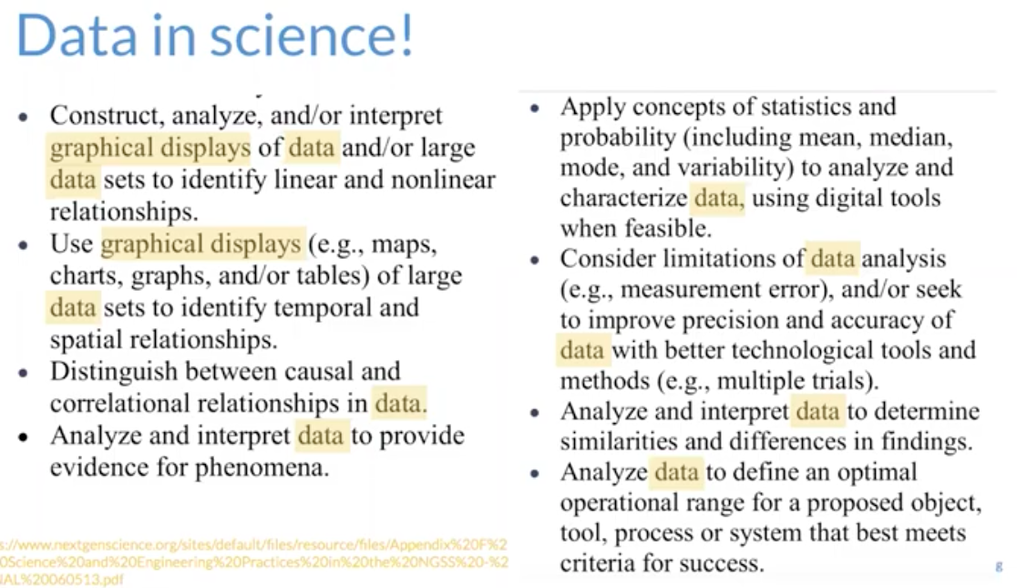


Data Literacy and NGSS – Science & Engineering
Kristin Hunter-Thomson
Faculty:
Rutgers
University
Dataspire.org

Slide 7
Data Literacy Skill
GLOBE Connections
Collect –
Organize –
Visualize –
Analyze –
Interpret –
Share –
- protocol and observer app
- data sheets
- graphs and charts
- observation – what is seen
- using data to answer question
- SRS/IVSS

Slide 8
Question for the Chat! –
Think about your content areas, teaching methods, student assignments, hands-on activities, etc… that you do with your students.
How do/can you support your teaching by incorporating data literacy skills? (collect, organize, visualize, analyze, interpret, share)

Slide 9
Data Literacy = GLOBE-NASA (and Distance Learning)
Options for Data Acquisition Collection/Organization
Student Toolkits (atmosphere, hydrosphere, biosphere)
GLOBE Observer App
On-line Data Portals
  My NASA Data
  BEACON (UC Berkeley)
Go Through the Process
Let students create visualizations
Let students analyze (talk about) what they see in the data
Give students an activity to interpret graphs or maps (what is it saying?)
Including giving students an opportunity to share their data visualizations, ask questions

Slide 10
On-line Data Portals
Cdc.gov/hchs/
Cdmo.branch.sc.edu
Pal.lternet.edu
Biobank.ctsu.ox.ul
Oceansofdata.org
Datanuggets.org
Tuvalabs.com
Youcubed.org
asombro.org/minidatajam/
mynasadata.gov
beacon.berkeley.edu
Data.gov
epa.gov
Noaa.gov
Usgs.gov
Nasa.gov
Census.gov

Slide 11
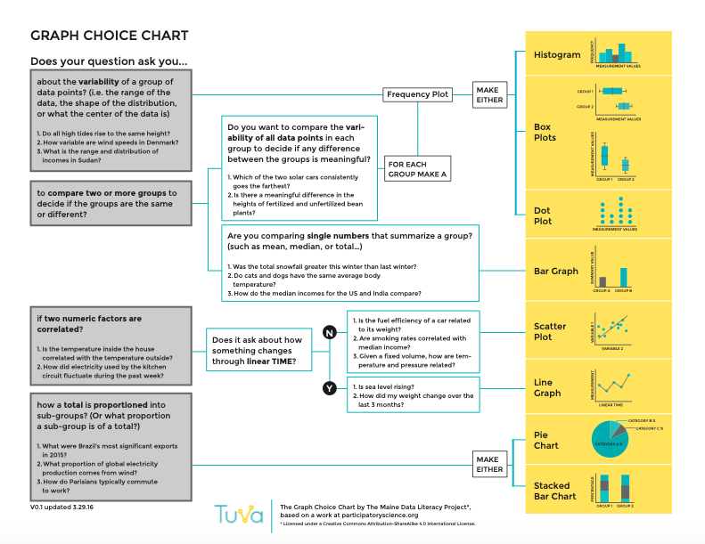
Teaching Graph Choice - Visualize
When working with data, what graph we use is dependent upon, at the broadest sense, three factors:
  what question we are asking of our data,
  what data we have, and
  who we are communicating to with our data.

Slide 12
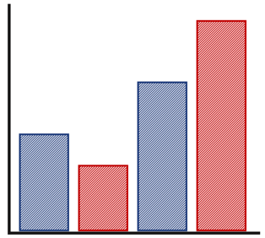
Visualize – Graph Types
(collect, organize, visualize, analyze, interpret, share)
Comparisons: Comparing two or more groups (same/different or correlated)?
  Compare/contrast
  Before/after
  Change over time
Bar Chart

Slide 13
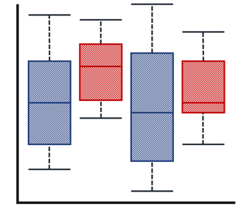
Visualize – Graph Types
(collect, organize, visualize, analyze, interpret, share)
Distributions: Looking at variability of a group?
  From/to
  Spread over time
Box plot

Slide 14
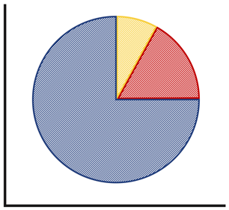
Visualize – Graph Types
(collect, organize, visualize, analyze, interpret, share)
Compositions: Looking at how total is proportioned into sub-groups?
  Parts to make a whole
  Percentages
Pie Chart

Slide 15
Data Literacy Activity
Next: Breakout rooms to engage in a
Data Literacy Activity – Graph Types
Work/Give It A Try As A Team
Link to Activity: https://docs.google.com/presentation/d/13ES-FgvRnTn4NGFZlgR0np2XJV3Aomh0z44biazR0_E/edit#slide=id.g8d10c80584_0_310

Slide 16
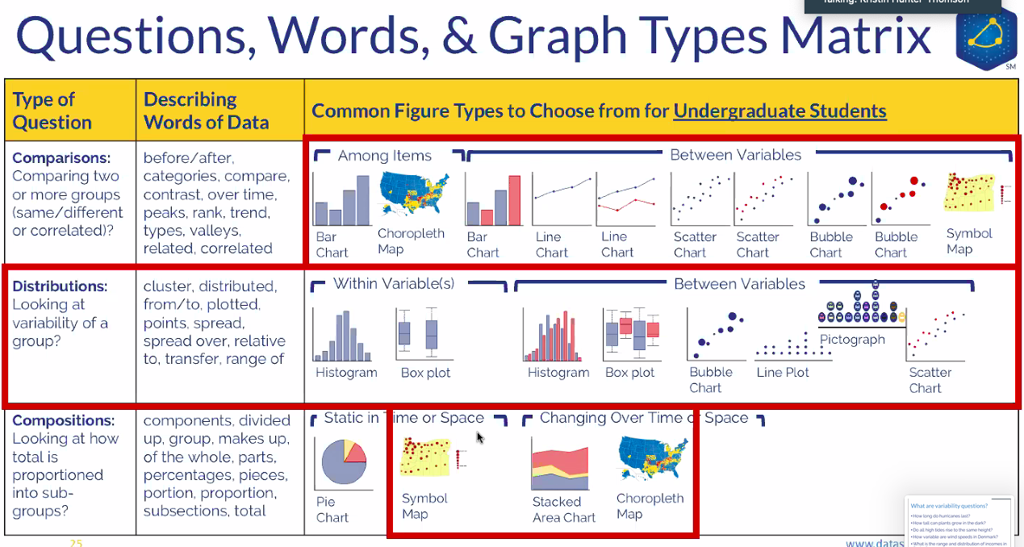

Slide 17
Graph Choice Chart

Slide 18
Analyze –
(collect, organize, visualize, analyze, interpret, share)
What is the story that the data are telling?
Data analysis is a process of inspecting, cleansing, and understanding data with the goal of discovering useful information, informing conclusions and supporting decision-making.
The main purpose of data analysis is to find meaning in data

Slide 19
Analyze – Student Sentence Starters
(collect, organize, visualize, analyze, interpret, share)
  Our results show _______
  The analysis we conducted addressed the research question because _____
  As shown in our data table, _____ data was collected and _______ data points were entered into the GLOBE database. (See data table and graph)
  A summary of our results shows _______
  According to our data, _______(this happened)

Slide 20
Data Literacy Activity
Next: Breakout rooms to engage in a
Data Literacy Activity – Analyzing Data
Work/Give It A Try As A Team
Link to Activity: https://docs.google.com/presentation/d/1BUdXIf07RNt1ERSlcrv_vtkZKa4F4JAr3ECf-769D50/edit#slide=id.g8d10c80584_0_310

Slide 21
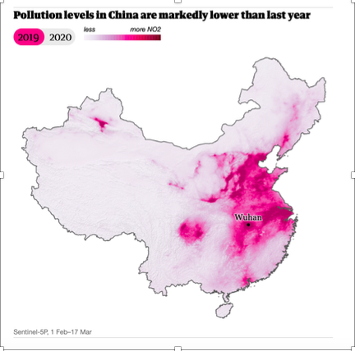
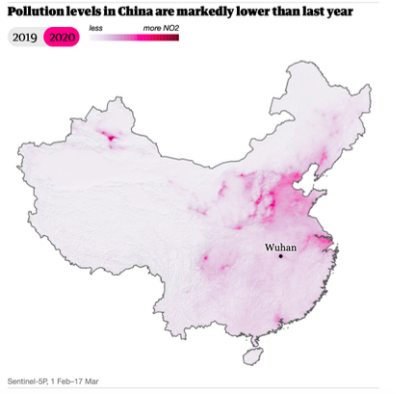

Slide 22
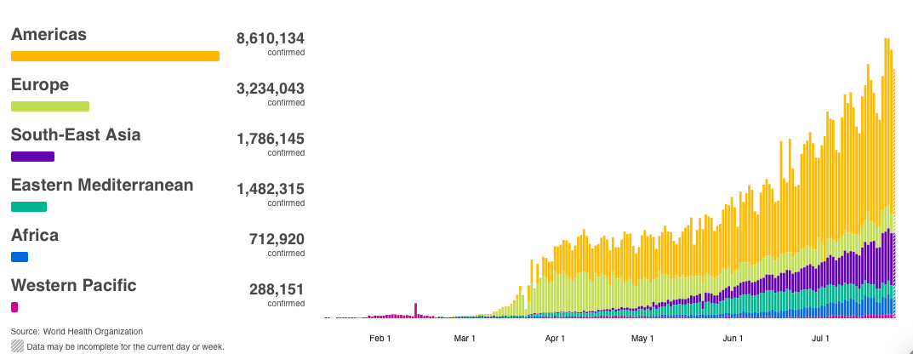
Confirmed COVID Cases By Region

Slide 23
Interpret –
(collect, organize, visualize, analyze, interpret, share)
Data interpretation refers to the processes through which data is reviewed for the purpose of arriving at an informed conclusion.
The interpretation of data assigns a meaning to the information analyzed and determines its signification and implications.

Slide 24
Interpret – Student Sentence Starters
(collect, organize, visualize, analyze, interpret, share)
  Our conclusion is (or is not) supported by the data because_____
  According to our data, ________
  These data are significant because ______

Slide 25
Data Literacy Activity
Next: Breakout rooms to engage in a
Data Literacy Activity – Interpreting Data
Work/Give It A Try As A Team
Link to Activity: https://docs.google.com/presentation/d/1jfE7yhYXYCIiJBBy2akM_0p6sf8fvxF4R744tcMIWHE/edit#slide=id.g8d11e5a58b_1_0

Slide 27
Confirmed COVID Cases By Region

Slide 28
How: 1-2-3- Steps to Data Literacy Integration

Slide 29
Step 1: Consider THIS with Data Literacy Integration
Data Literacy is a PROCESS
There are many parts to a whole (collect, organize, visualize, analyze, interpret, share)
Consider incorporating Data Literacy outside of science
  Elections/Politics – election states (red states vs. blue states)
  Census 2020
  Math – mean, median, mode, percent, fraction
  English – writing an argument from a data set
  History – explore data showing how humans have changed Earth's land LINK

Slide 30
Data Visualization
Step 2: Teach students the question not the chart
Make the connection from question/process to choose what graph type they may want to use
Show (processed or collected) data and have students ask questions about the data – What kind of question do the data answer?

Slide 31
Step 3: Data Literacy is a Learning Progression
Example:
There are 4 graph types that elementary school students can learn to view, work with, and create:
Bar/Column Charts
Dot Plot/Line Plot (1 axis)
Pictograph
Pie Chart
There are 7 graph types that middle school students can learn to view, work with, and create (4 new and 3 repeated graph types from elementary school):
Bar/Column Charts (repeat)
Box Plot
Dot Plot/Line Plot (1 axis) (repeat)
Histogram
Line Chart/Graph (2 axes)
Pie Chart (repeat)
Scatter Chart/Plot
There are 8 graph types that high school students can learn to view, work with, and create (2 new and 6 repeated graph types from elementary and middle school):
Bar/Column Charts (repeat)
Box Plot (repeat)
Bubble Chart
Histogram (repeat)
Line Chart/Graph (2 axes) (repeat)
Pie Chart (repeat)
Scatter Chart/Plot (repeat)
Stacked Area Chart
Dataspire’s Graph Type Matrix Activity resources by grade bands

Slide 32
Data Literacy On-Line Resources/Lessons
https://scied.ucar.edu/globe-data-explorations
http://dataspire.org
http://mynasadata.larc.nasa.gov
https://www.h2oforlifeschools.org
https://www.stlouisfed.org/education/lessons-for-teaching-data-literacy
https://www.nationalgeographic.org/article/geography-and-literacy-connection/
https://www.lessonplanet.com/
https://www.edc.org/defining-data-literacy-students
https://everfi.com/blog/k-12/teaching-data-literacy-skills/
https://www.nationalgeographic.org/education/classroom-resources/

Slide 33
Suggestion: Data Literacy Warm Up Activities
Pre/Post Warm Up
Give students Data Literacy Warm-Up
Export responses to spreadsheet
Score with √ or X or ?
Give Tracy your # of each
Link: Data Analysis Warm Up
Link: Data Interpretation Warm Up

Slide 34
DATA LITERACY SKILLS MATTER
Next Steps:
Give Students “pre” data literacy warm up(s) before you begin integrating data literacy skills
Questions??? Contact Me:
tostrom@Berkeley.edu

