Slide 1
Watersheds
Processes and patterns in the landscape that are driven by water
Notes:
Get a few ideas and define a watershed

Slide 2
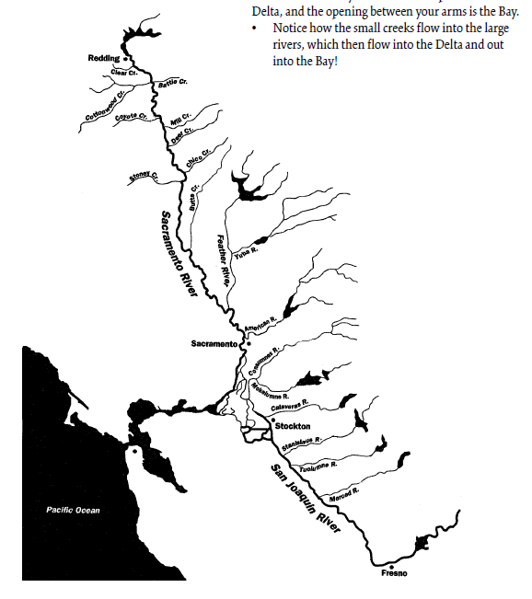
Watersheds – ridges and valleys in your hands
Adapted from Save the Bay’s San Francisco Bay watershed curriculum
https://www.savesfbay.org/sites/default/files/WatershedCurriculum.pdf
Notes:
Ask what is a watershed – get some ideas
Introduce the idea that the Bay area has many important watersheds – wildcat creek flows through the east by hills and Richmond, the sacramento and san joaquin rivers flow into the SF Bay

Slide 3
Simple watershed model – with paper!
Ridges and valleys can be represented by a simple model that looks like the landscape
Crumple your paper to create your model
Write predictions in your notebook
→Where will water run the fastest? Where will streams and lakes form?
Draw the divides (in brown) and streams (in blue) on your model
Notes:
Take a piece of white paper. Crumple it up and then flatten slightly so it looks like a hilly landscape.
Place it on a tray or in a tub with one end slightly elevated.
Observe the landscape and make predictions in your notebook-- Where will water run the fastest? Where will streams and lakes form?
Draw in brown lines on ridges and high points and mark where you think bodies of water (streams, lakes, bays) will form in blue on your paper model

Slide 4
Simple watershed model – with paper!
Make it rain!
Observe how the rain moves across the landscape
Write observations in your notebook:
Did you draw water in the correct places?
Where did the rain move quickly and slowly in the watershed?
Did the water pool up anywhere?
Notes:
use a sprayer to make it rain on your landscape
Observe where the water goes

Slide 5
Simple watershed model – with paper!
Make it rain!
Observe how the rain moves across the landscape
Write observations in your notebook:
What happened?
Did you draw water in the correct places?
Where did the rain move quickly and slowly in the watershed?
Did the water pool up anywhere
Vocabulary:
Slope, ridge, valley, drainage area, runoff

Slide 6
Simple watershed model – with paper!
Evaluate the model
In what ways does this model represent the real world, what processes are represented well?
What is missing in the model?
what else could you do with this model -- how might it help you visualize or predict things that might happen in the real world?
Notes:
Here you can talk about the importance of gravity, and about how difference kinds of surfaces absorb or repel water.

Slide 7
Simple watershed model – with paper! →possible extensions
You can use this model to explore how pollution is transported into watersheds with rainstorms by adding pollution points to the landscape.
Draw a housing development on your model, in red.
When it rains, does the water flow across the housing development?
How does the water change color with human development in the watershed?
Where would you put a development to reduce pollution in the stream?

Slide 8
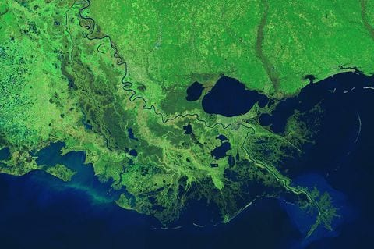
How does a river form?
head
mouth
Mississippi River Delta

Slide 9
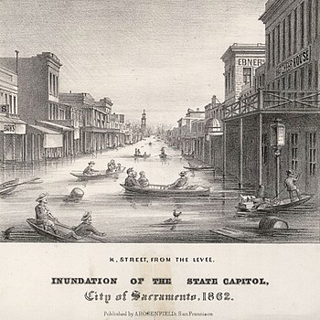
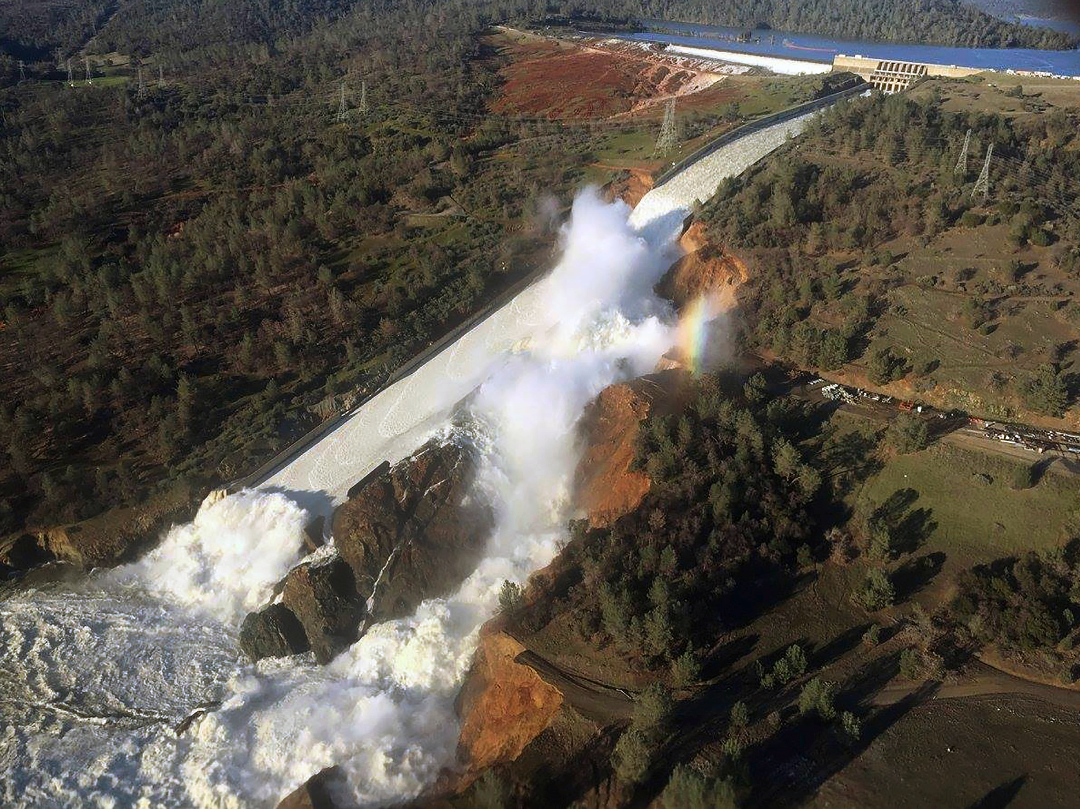
How does a river form? Why is the process of river formation important?
1862 flood of Sacramento
2017 Oroville Dam spillway crisis due to fast erosion rates

Slide 10
How does a river take its shape?
Set up stream tables!
In your notebook during and after your first run notice:
What does the surface look like?
Where is the head of your river? Describe what is happening there.
Where is the mouth of the river? What is happening there?
How would you describe what happened?
What shape did your river take?
How deep is your river? How wide?
Vocabulary:
Stream channel, delta, erosion, deposition, alluvial fan, meander
Notes:
See River Cutters master lesson plan or see FOSS for details on set up

Slide 11
How does a river take its shape?
Collect data and record it in a data table in your notebook
Amount of water that ran through the channel | Width at the head (cm) | Width at the middle (cm) | Width at the mouth (cm)
5mL
10mL
100mL
500mL
Notes:
You can also have students collect some quantitative data

Slide 12
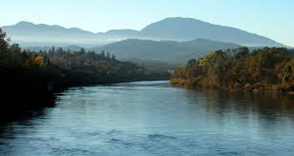
How does a river take its shape?
What are some differences between these two rivers?
Sacramento River
Elder Creek, Branscomb CA

Slide 13
How does a river take its shape?
What are some factors that we can test?
In your notebook:
How does _____ affect ________ ?
I predict that_______ because __________
Notes:
After doing a standard run with the stream tables, students can do their own experiments by changing something in the set up.
Ideas include changing the slope, rate of water flow, size of substrate (add rocks or pebbles), type o surface – add paper or plastic, add contours to the landscape, reinforce stream banks, add houses or bridges, make pollution points and wee how they are moved by the water in a flowing landscape.

Slide 14
How does a river take its shape?
Collect data and record it in a data table in your notebook
Amount of water that ran through the channel | Width at the head (cm) | Width at the middle (cm) | Width at the mouth (cm)
5mL
10mL
100mL
500mL

Slide 15
How does a river take its shape?
Does your data support your prediction?
My prediction that _______ is supported because _______
My prediction that ______ was not true because _________
Were you able to test the factor that you intended to test?
What would you change next time?
What are some factors you could test with your students?

Slide 16
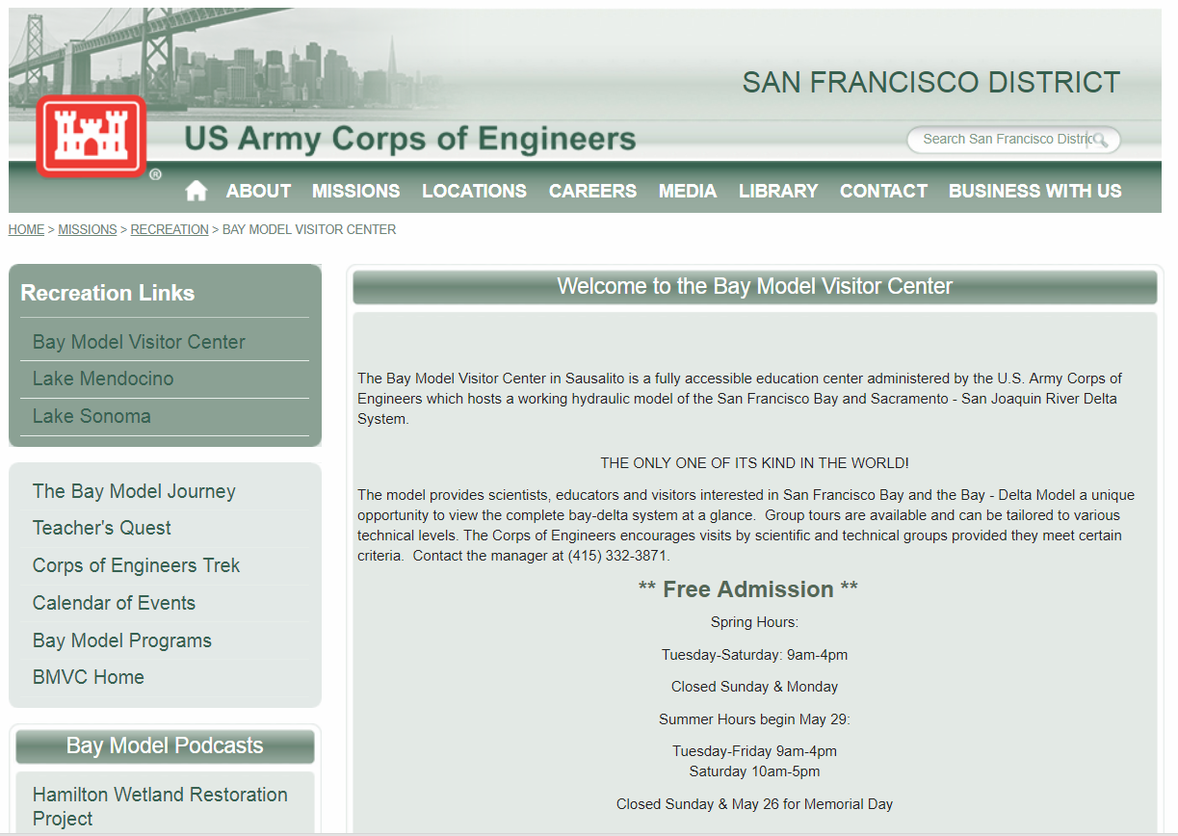
Field trip idea: San Francisco Bay Model in Sausalito
Admission to the Bay Model is FREE!
https://www.spn.usace.army.mil/Missions/Recreation/Bay-Model-Visitor-Center/

