Slide 1
Data Analysis – Bug Hunt
(3-6)
Day 2 Tuesday

Slide 2
Welcome Back
Welcome back. Did you find that activity fun!?
Do you think there was a difference between the two habitats?
Can anyone think of a way to visualize our findings?
Let’s visualize our data by plotting it!

Slide 3
Questions - Plotting the data
We want to answer two questions with our data:
Are there more arthropods in habitat 1 or 2?
Are there more types of arthropods in habitat 1 or 2?

Slide 4
Identification Instructions:
Identify and separate the arthropods into the different types.
This can be as general as insect or specific as ant/spider/beetle/butterfly
To help you do that we have this worksheet that shows you ID different types of insects and non insect arthropods.
(For K-2 can focus on total numbers found in a give place, or other general features, if trying to ID types is too difficult)

Slide 5
Filling out the Worksheet
After you decide how many types of insects you have, fill in the bug types (or simple counts of numbers found in each habitat) in your given worksheet.
Note – you can also have students make their own table in their notebooks
After, report how many types (or numbers) you found in each habitat.
(for K-2 you may want to make a class table on the board)

Slide 6
Sample worksheet for counting insects
Habitat Type | Bug Type 1: | Bug Type 2: | Bug Type 3: | Bug Type 4: | Bug Type 5:
Habitat 1:
Habitat 2:
While they are filling this out pass out posters paper.

Slide 7
Another sample worksheet/table for counting insects
Habitat | Number of insects | Number of spiders
Habitat 1: (e.g. garden)
Habitat 2: (e.g. grass)
Habitat 3: (e.g. play structure)
For K-2 could do a class table on the board

Slide 8
Plot your results on a poster
Ok now that you have your final counts, let’s plot the data!
Assign a color for each type of arthropod.
Make a bar graph
Y- Axis is count
X Axis is the habitat
Color stickers are the types of arthropods.
Alternative is to use colored magnets on a magnetic whiteboard to create a class graph

Slide 9
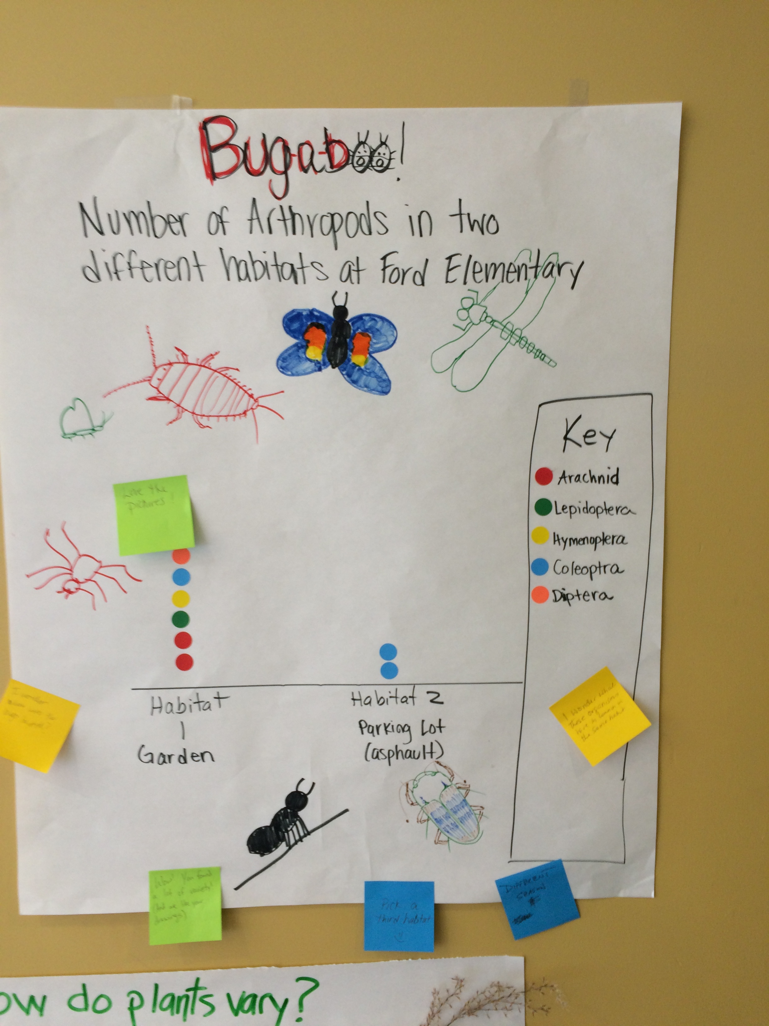
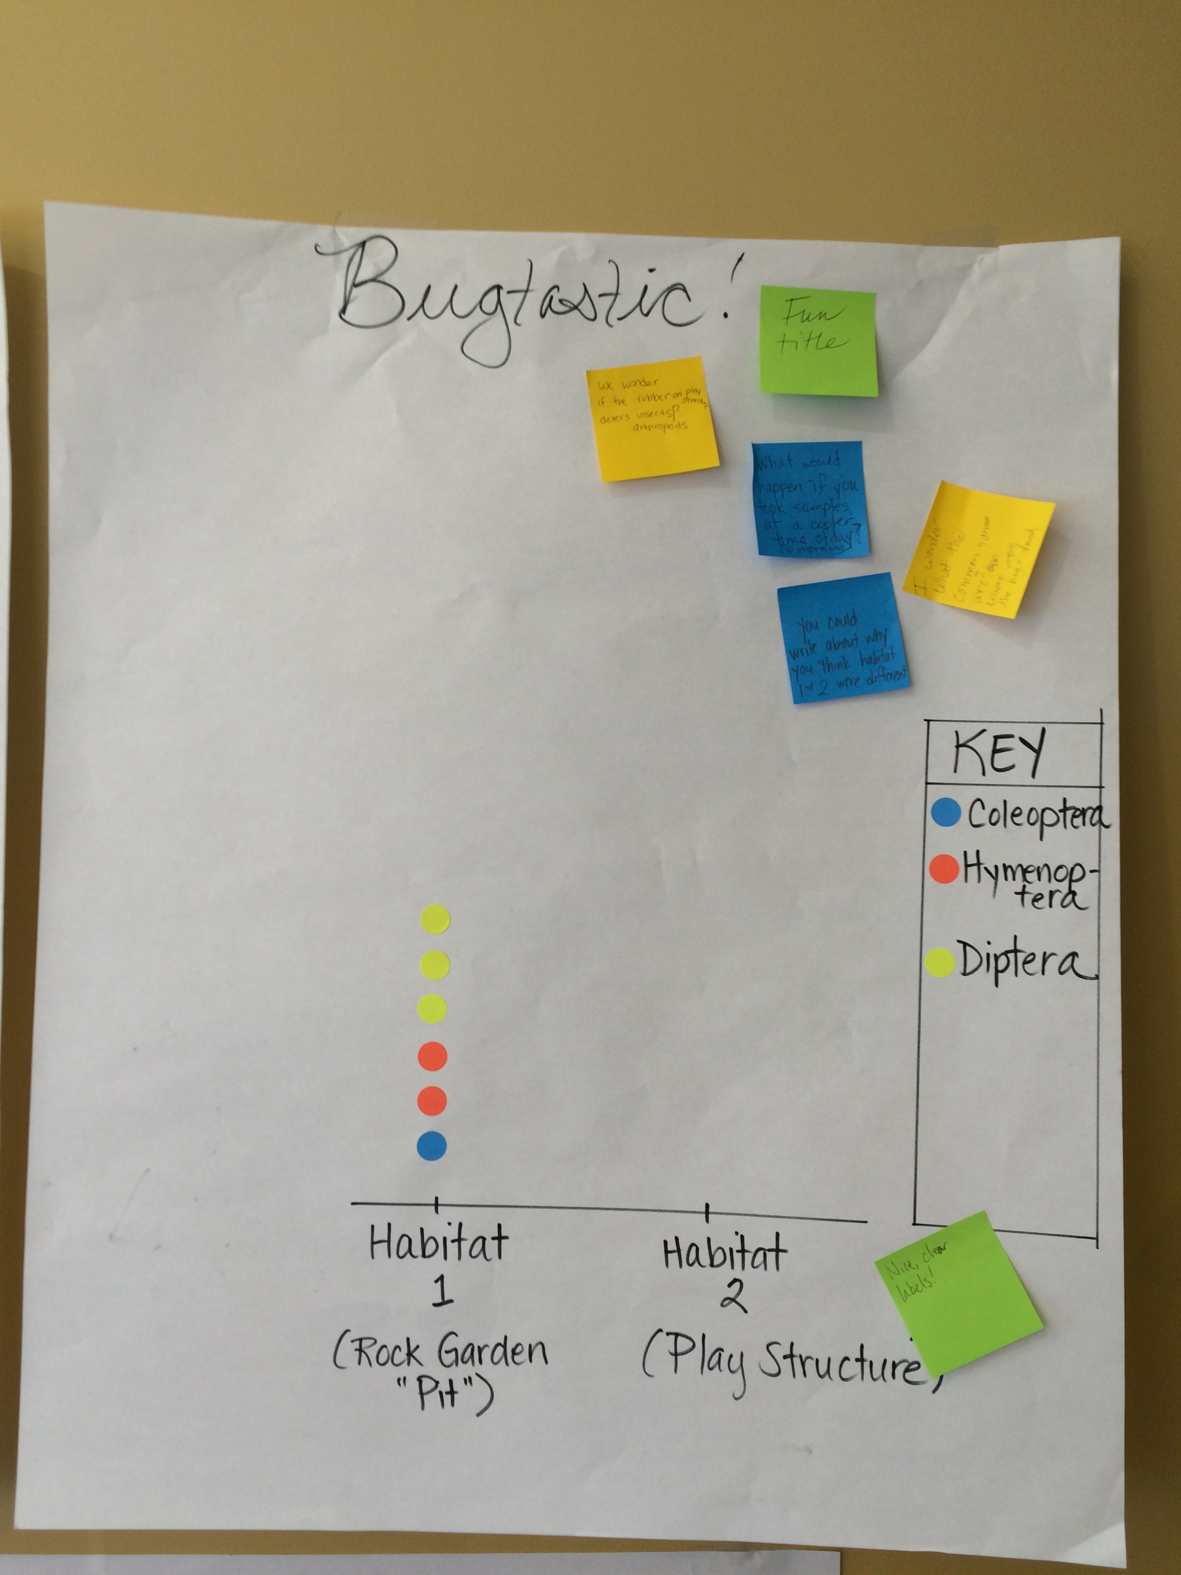
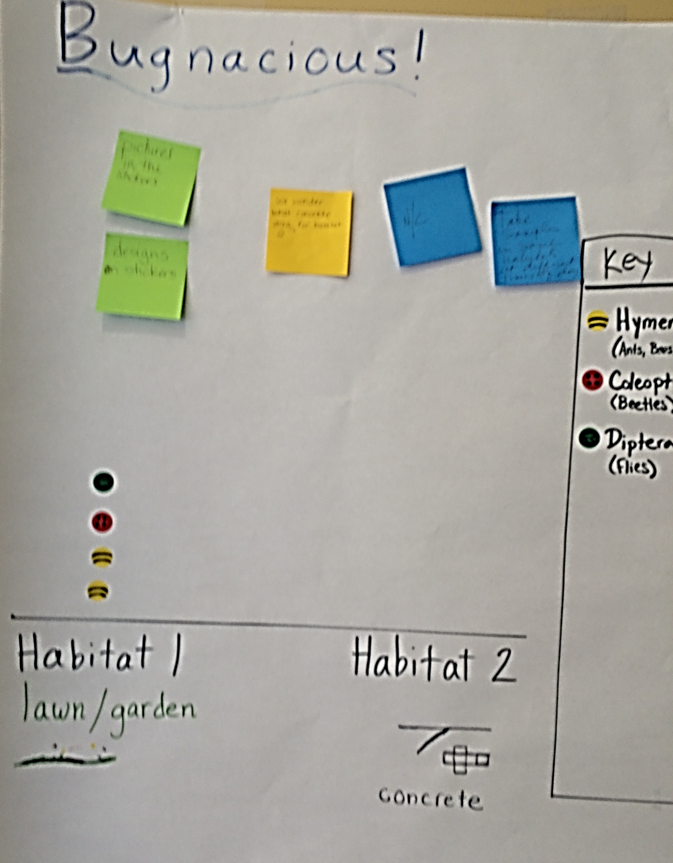
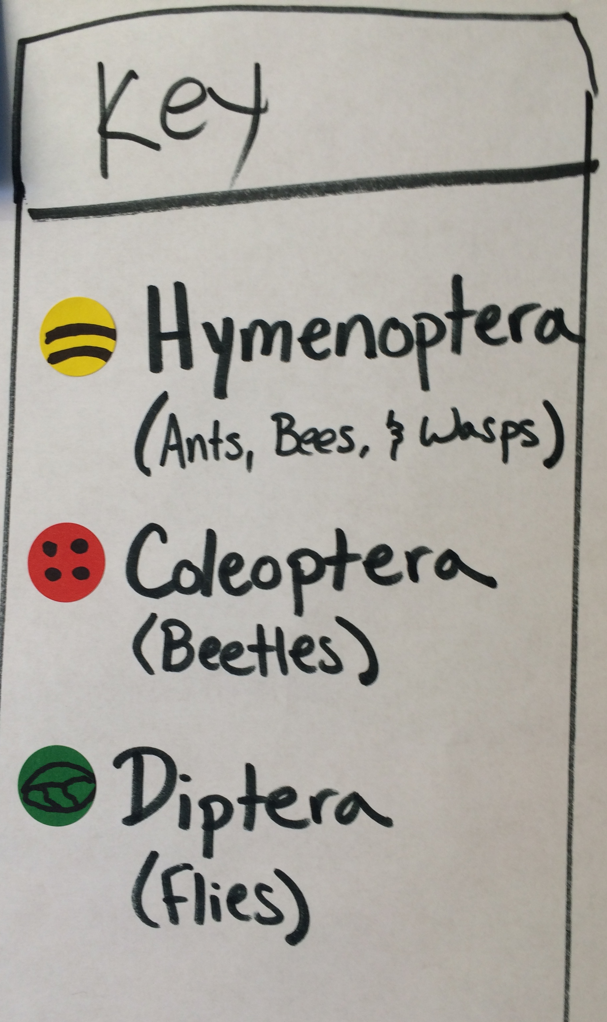
Demo of how to plot the data
Demo on the white board
First make & label your x and y axes
Give it a title (e.g. Bugs in our schoolyard!)
Use the colored stickers to represent your types of bugs in each habitat.
Make a legend showing what color represents each bug type
take ~5-10 minutes to plot the data.
(note - K-2 used magnets)

Slide 10
Results Statement
Let’s re-examine our initial predictions.
“I predict I will find more insects in _____ than in the _____, because _________________.”
Looking at your data, make another statement in your notebook whether your original prediction was supported or not
My prediction is ________ (supported/not-supported)
because we found ________ in (habitat 1) and we found_____ in (habitat 2).

Slide 11
Wrap up Discussion
Presentations
I want you to present your findings to the class to let us know what you found!
--or do a poster gallery walk with post-it notes so that students can give each other written comments; comments can be used for subsequent poster revisions

Slide 12
Wrap up discussion
While we discussed the number of arthropods we find in different habitats, it is also important to think about the types of arthropods in different habitats.
Did you find differences in the types of insects in different habitats?
What features of the environment made for good insect habitat?
We just measured the biodiversity in our school yard!

Slide 13
Biodiversity
Let’s break down the word:
Bio = Short for Biology - the study of living things
Diversity = The number of different types of things.
Can anyone define biodiversity?
Biodiversity – The variety of different things living in a given place.

Slide 14
Showing Biodiversity
Show the insect cabinet with large flashy bugs.
Did we find any bugs that looked like this?
Why or why not?
Where might we be able to find these?

Slide 15
Wrap up – Biodiversity
So we looked at insects in our schoolyard but let’s zoom out into global habitats around the world!
Do we expect to find more biodiversity in a place like:

Slide 18
Biodiversity Discussion
Why do we find more biodiversity in one place over another?

Slide 19
The USA is 5x the size of Indonesia!

Slide 20
Connection – Human Disturbance
What do you think would happen if these diverse habitats disappear?
What can we do to preserve biodiversity?

