Slide 1
Explaining the Unexplainable through Crosscutting Concepts
The Bombardier Beetle

Slide 2
Take a Guess!
Bombardier beetles emit a toxic spray at over boiling temperature!
How do you think they accomplish this feat without hurting themselves?

Slide 3
Crosscutting concepts
Structure and Function
System & System Models
Patterns
Scale, Proportion, Quantity
Cause & Effect
Energy & Matter

Slide 4
Bombardier Video - Deep Look

Slide 5
Crosscutting Concept – 1. Structure Function
Notes:
The beetle has an anatomy to function like a chemistry lab!
Chemicals are kept separate from reactive enzymes via a muscle controlled valve. Spook them, and they open the valve, emitting an explosive spray!

Slide 6
Crosscutting Concept – 1. Structure Function
Notes:
This is a dissection done in my lab. You can see the fingery secretory cells where chemicals are manufactured.
The big white bulbs are where the chemicals are stored.
The dark bit is the reaction chamber that is heavily armored like the beetle exoskeleton for withstanding the explosive spray!

Slide 7
Crosscutting Concept – 2. Systems & System Models
Release valve, allow chemicals to react with enzymes!
Repeat!
After cooling, the valve opens again.
Pressure builds with explosive heat, closes the valve.
Notes:
The bombardier beetle has an automatic, repetitive system that allows it to have a pulsed jet spray at 500 sprays/second! This system is iterative and uses expansion from heat as an automatic way to stop reactants from flowing in, and repeating the process once the chamber cools. Can anyone think what this remind them of?

Slide 8
Crosscutting Concept – 3. Pattern
Notes:
We see the use of heat to increase pressure in other systems such as the pistons in engines. Like the bombardier beetle, in engines, heat expands a “reaction chamber” to exert a great deal of force.

Slide 9
Crosscutting Concept – 4. Scale, Proportion, Quantity
Notes:
The system of the bombardier beetle is being studied by scientists for potential use in: 1. Fire Extinguishers
2. Inhalers
Effectively scaling up the size and efficiency of this jet propulsion system for applications in industry!

Slide 10
Explaining the impossible
In order to understand how this system evolved, we are looking at the genes involved in this system.
How can we identify which genes are used for the production of the toxic chemicals!?

Slide 11
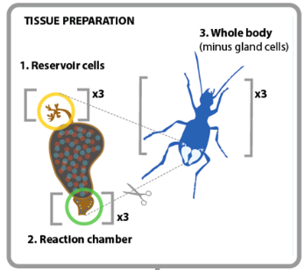
Differential Gene Expression!
Notes:
We can detect what genes are more active in the chemical production factory!
Compare the rest of the body vs the

Slide 12
Notes:
Here is an example of a gene we found that is used in the production of the chemicals.
This is a key player in the bombardier beetle system’s assembly line

Slide 13
Notes:
It’s like removing part of an assembly line in car production.
How well would a car function if we “knocked out” the wheel installation component?

Slide 14
Evidence through Experiments – Validation!
How can we validate this “candidate” gene we think is crucial to the pathway?

Slide 15
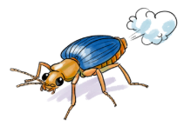
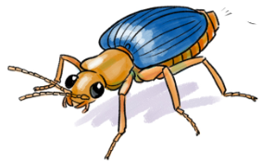
Cross Cutting Concept – 5. Cause & Effect
Notes:
If we knock out these genes, we may get a bombless bombardier beetle.
What do we call the top experiment in which we don’t change gene expression in a “normal beetle”?

Slide 16
Cross Cutting Concept – 5. Cause & Effect
Control
Variable
Notes:
In our experiments in the lab, we use controls to verify that our tampering with the beetles is not the cause of our results.
The controls are also injected with gene knockout juice, but the target gene is not even a beetle gene.

Slide 17
Cross Cutting Concept – 6. Matter & Energy
At its root, the bombardier beetle system described is mostly about energy produced from a chemical reaction!
The bombardier beetle serves as a great link between the life sciences and the physical sciences.
In fact, there are many lessons out there that use the same class of enzymes bombardier beetles use, peroxidases. Here is an example (if time permits):
Peroxidase video - rad music
Notes:
Have you treated an open wound with hydrogen peroxide and saw it bubble? This is one of the reactions occurring in bombardier beetles!

Slide 18
Everyone Uses Cross-Cutting Concepts
Basically, we all use cross cutting concepts!
Scientists, teachers, engineers, students.
We all see patterns in the world and try to explain them.
Notes:
Weather
Stock market
Which café has the best Chai latte

Slide 19
Thanks!

