Slide 1

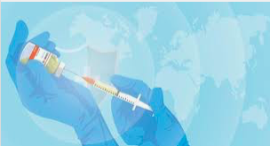
All About
Vaccines
Written by Carol Mirenda,
with inspiration from Tyler Chuck,
for Community Resources for Science, 2021

Slide 2
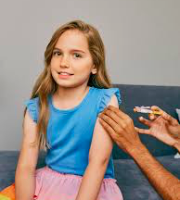
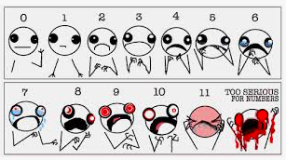
So what is a vaccine?
Hey, I won’t sugar coat it, a vaccine involves a shot. Yep, a needle in the arm (and some times other places in your body).
How many of you have gotten shots?
On a scale of 0 to 10, with 0 being not painful or scary and
10 being super painful or scary, what was it like for you?

Slide 3
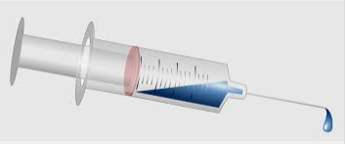
The stuff that is injected into your body is the important part
Syringe
Needle
Vaccine
Syringe: The container for a vaccine
Vaccine: The stuff in the syringe
Needle: It pokes into our skin, which allows the vaccine to be injected

Slide 4
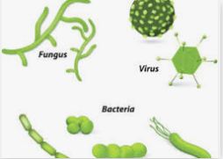
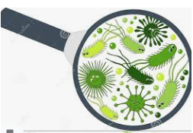
The stuff in the syringe is the vaccine
A vaccine is a way of protecting us from microbes.
Microbes are microscopic creatures that can invade our bodies.
Examples of microbes:
  * Bacteria * Viruses * Fungi

Slide 5

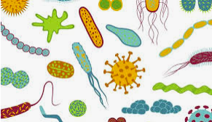
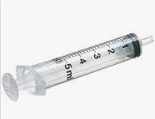
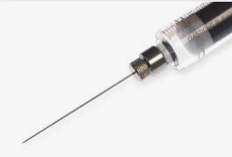
Game time: Match the word to the picture, then the picture to the best definition
Word
Syringe
Needle
Vaccine
Microbe
Picture
Definition
examples are bacteria, viruses, fungi
the container for a vaccine
the stuff that is in the syringe
pokes our skin which allows the stuff in the syringe to be injected
A
B
C
D

Slide 6
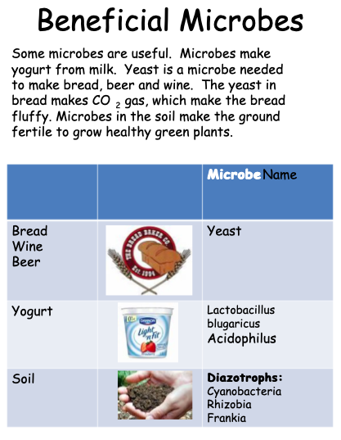
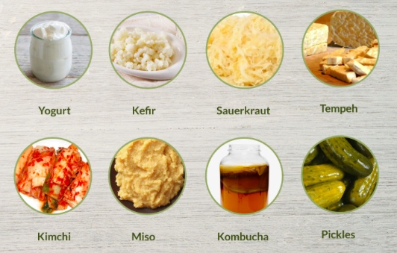
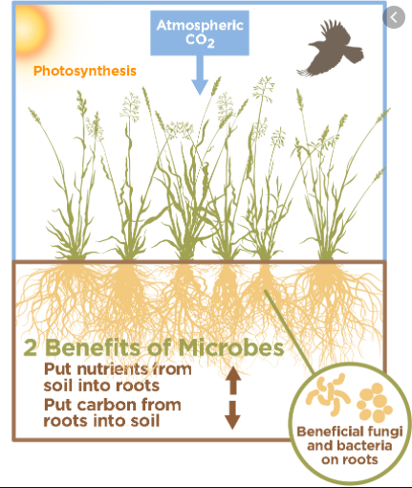
We are surrounded by microbes
To be clear, not all microbes cause us harm.
In fact, many of them are good for us and other living things.
And good things to eat are made with beneficial “good” microbes!

Slide 7
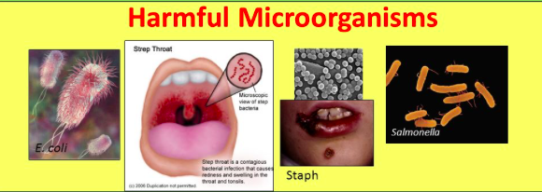
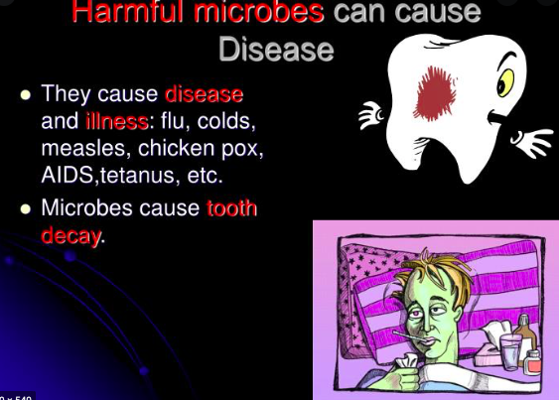
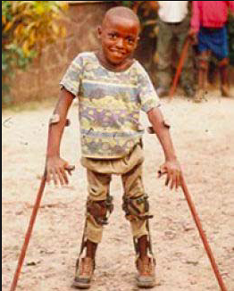
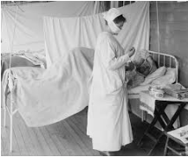
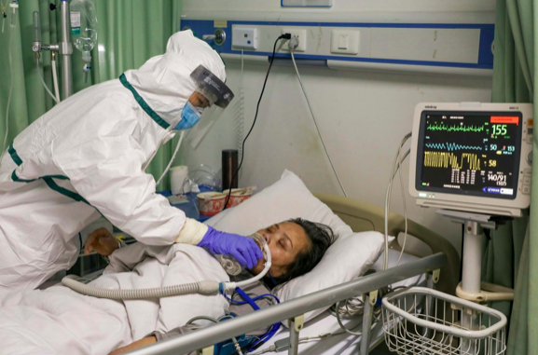
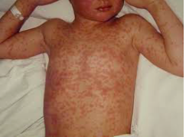
But, the harmful “bad” ones can be really terrible
and we need protection from these bad, illness causing microbes.

Slide 8
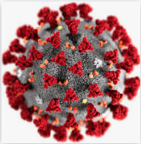
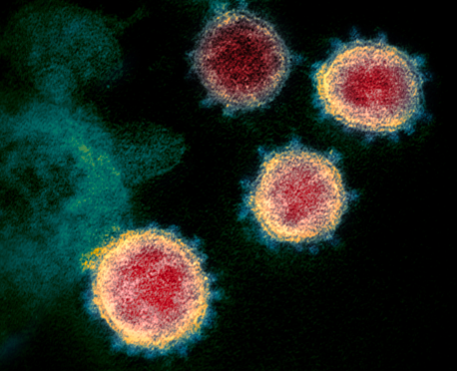
Right now, we have a bad microbe problem
This microbe is a virus. Its name is SARS-CoV-2
It causes a disease named COVID-19
It is because of this virus that we wear masks, wash our hands a lot, and stay far away from people.

Slide 9
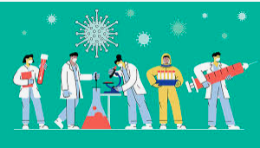
COVID-19 is the illness or disease
COVID-19 is an infection and causes all sorts of trouble within our bodies: Cough, fever, headache, breathing problems, nerve problems, loss of smell, stomach problems, and other issues.
Since we know that the SARS-CoV-2 virus is responsible for this illness several pharmaceutical companies have made vaccines to fight this virus.
Any one of the vaccines will protect you from
getting sick from the virus

Slide 10

Questions and Answers
Questions
Are we surrounded by microbes?
Are all microbes bad for us?
Name a way we can protect ourselves from bad microbes.
What is the name of the disease caused by the SARS-CoV-2 virus?
Answers
Yes, they are all around us
No, some are beneficial to us
Get a vaccine; wear a mask; wash hands
COVID-19

Slide 11
How does the vaccine work?
First, we need to know about the SARS-CoV-2 virus that causes COVID-19
For making a vaccine, we know
what part of the virus is used to
attach and then infect our cells.
It is called the spike protein.
This protein is the spikey knobs on the outside of the viral particle

Slide 12
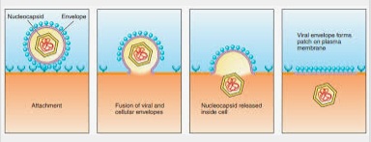
The spikes attach the virus to our cells
the virus
cell surface
Insides of virus
released into
the cell
inside of cell
Once attached, the virus injects its insides into our cells.

Slide 13
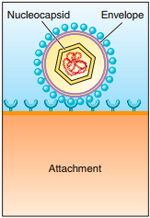
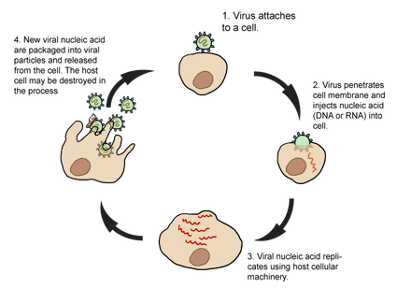
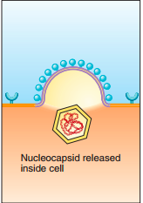

The virus hi-jacks our cells!
the virus
whole cell
Eventually, new virus busts out of the cell
and these new particles attach to other cells.
The insides of the virus commands our cell to make more viral particles.
The process is repeated over and over.
This entire process is called viral replication

Slide 14
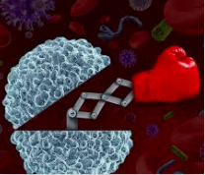
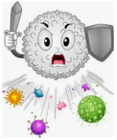
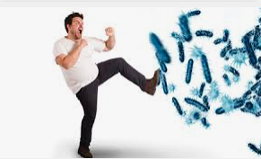
Our body does fight the virus
The good news is…..
But, some times the speed at which the virus replicates is faster
than the speed at which our body can fight back,
so we get sick.

Slide 15
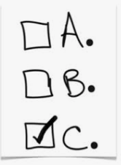
Review: Multiple Choice
Which part of the virus is used to attach itself to our cells?
A. The spikes on its outside
B. The insides of the virus
C. The virus does not attach
What does the virus do once it invades our cells?
A. It performs cartwheels
B. It commands that our cell make more virus
C. It makes us burp
Does our body try to fight the invading virus?
A. Yes
B. No

Slide 16
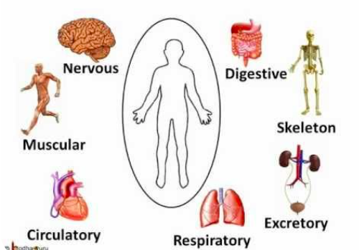
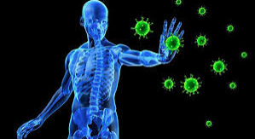
How does our body fight microbes?
You know about the various systems of our bodies…for example:
Well, we have a Microbe Fighting System called the
IMMUNE SYSTEM

Slide 17
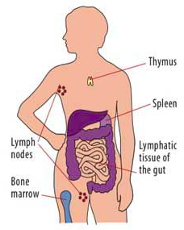
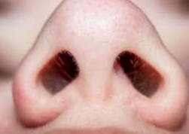
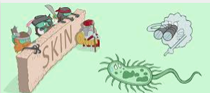
Our Immune System is composed of these body parts:
🔸 Nose
🔸 Skin
🔸 Spleen
🔸 Thymus
🔸 Bone Marrow
🔸 Lymph nodes and vessels
Some of these body parts, like the bone marrow and thymus, are home base for specialized immune cells

Slide 18
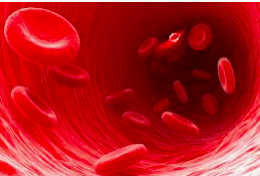
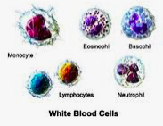
Specialized Immune Cells
You have heard of red blood cells, right?
I bet you have also heard of white blood cells.
We have several kinds of white blood cells
in our body.
Let’s concentrate on two kinds of special white blood cells called lymphocytes:
B cells and T cells

Slide 19
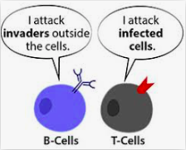
B Cells and T Cells are a body invader’s worst nightmare……like in the movie “Home Alone”
B cells are our defensive force outside of our cells
T cells are our
defensive force if invaders get
inside our cells.

Slide 20
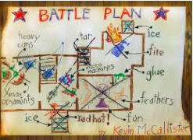
Remember Kevin’s Battle Plan?
Kevin had strategies for fighting the home invaders both outside the house and inside the house.
Let’s apply this idea to the B & T cells and pretend that:
The intruders in “Home Alone” are harmful microbes
Kevin’s house is our cells
Kevin’s plans outside the house are B cell activities
and Kevin’s plans inside the house are T cell activities

Slide 21
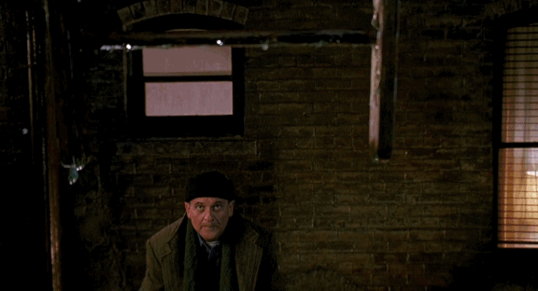
And remember: These are just movie clips and no one is getting hurt for real.
This would be a B cell job: Fighting invaders outside of cells

Slide 22
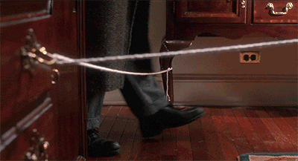
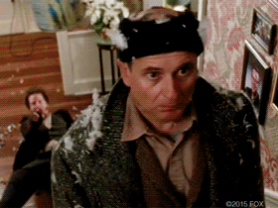
T cells jobs are those that defeat invaders once they are inside the cell

Slide 23

This one is my favorite.
You can see the intruder, a bad microbe, enters the house or cell, as he climbs through the window.
He is thinking that all is well when…..
another T cell
win!

Slide 24
Questions
Questions and Answers
Answers
What is the name of our bodies’ Microbe Fighting System?
Name a body part which is part of your Immune System.
B cells defend which part: Outside the cell or inside the cell?
The Immune System
Nose, Skin, Bone Marrow, Thymus,
Spleen, Lymph nodes & vessels
Outside the cell

Slide 25

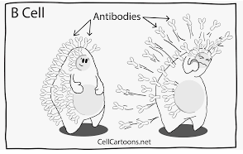
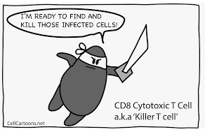
B cells and T cells….to the rescue!!
Our specialized immune cells, B cell and T cells, are always present
in our bodies. However, it takes time for them to react to invaders.
But, what if our B cells and T cells could be prepared for an invader?

Slide 26
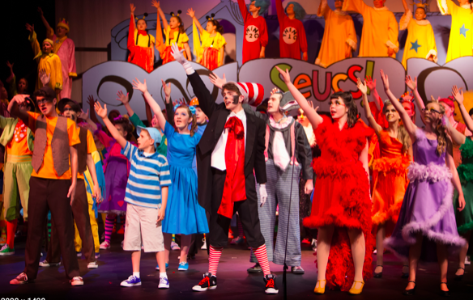
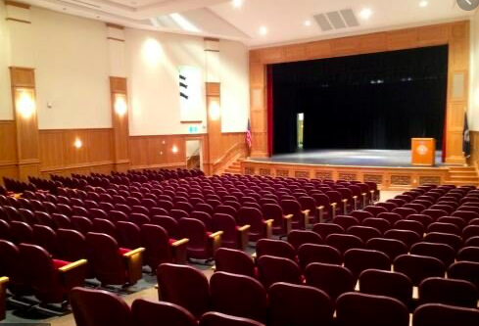
That’s where vaccines come into the picture.
Vaccines provide our Immune System with
a Dress Rehearsal
All the drama and costumes and lighting
but no audience
in other words, no disease

Slide 27
That’s right, a vaccine gives the B and T cells the opportunity to prepare for a bad microbe ….
without causing the disease
A vaccine does this by imitating, or looking like, a microbe
or part of a microbe.
As far as the B and T cells are concerned they just see the vaccine as a foreign substance, an invader, and so the cells gear up to fight it.
The vaccine activates the B and T cells

Slide 28


The bonus is that the B and T cells remember this invader
So if the virus actually shows up in your body,
that is if you get infected, your B and T cells are ready.
They recognize the microbe, already have their weapons made,
and can beat the microbe before it makes you sick.

Slide 29



For the SARS-CoV-2 virus, it is the spike protein that is in the vaccine
The vaccines against this virus are essentially nothing by a bunch of spike proteins.
The whole virus
The spike proteins
The vaccine
But, the spike protein by itself cannot cause COVID-19.
Only the whole virus can make us sick.

Slide 30

Summary
Vaccines give us protection from harmful microbes without causing the illness that the microbe would
Vaccines activate our Immune System, specifically our B cells and T cells, before an infection by the microbe
Activated B cells and T cells are prepared
to defeat the harmful microbe before it
can make us sick.

Slide 31
Let’s walk through this again…..
Put the statements below in the best order that tells this story
Sometimes the Immune System cannot react fast enough to keep us from getting sick
If we get infected by the actual microbe the Immune System is ready to beat the microbe before it can make us sick.
Our Immune System is always at work
The activated B cells and T cells remember what the vaccine represented: A harmful microbe
A vaccine imitates a microbe (basically fakes out the Immune System) which activates B cells and T cells
Our Immune System is always at work
Sometimes the Immune System cannot react fast enough to keep us from getting sick
A vaccine imitates a microbe (basically fakes out the Immune System) which activates B cells and T cells
The activated B cells and T cells remember what the vaccine represented: A harmful microbe
If we get infected by the actual microbe the Immune System is ready to beat the microbe before it can make us sick.

Slide 32




Slide 34
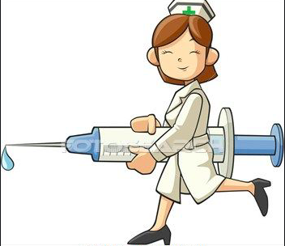
Glossary
Vaccine – Prepares immune system to recognize a future invading microbe
Injection – a substance, such as a vaccine, that is placed into a body with a needle
Microbe – a microscopic creature such as bacteria, viruses, or fungi
SARS-CoV-2 – the name of the virus that causes COVID-19 disease
COVID-19 – a disease that causes sickness and even death
Pharmaceutical – a type of company that makes vaccines and drugs
Immune System – our bodies’ Microbe Fighting System
B cells and T cells – the special immune cells that attack invading microbes and the cells that a vaccine prepares for a possible future invasion of our body

Slide 35

Take home messages
Item
B cell
T cell
Vaccine
Job
Defend against microbes outside our cells
Fight microbes that get inside our cells
Prepare our B and T cells so they can quickly fight and defeat an invading microbe.

Slide 36
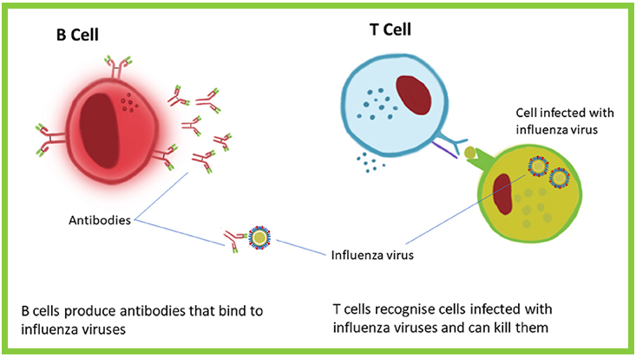
It’s all about preparing our B and T cells
Just as the virus would, the vaccine prompts B cells
to make antibodies. They recognize the spike protein.
Antibodies are a B cells
weapon.
If later the virus does infect
your body, the B cells
remember seeing the spike
protein. The antibodies
to the spike protein can
immediately go into action.
They attach to the spike
protein on the viral
surface and tag the virus for
destruction.
The vaccine shows T cells the spike protein, which then
recognizes it as “foreign”.
If the T cell sees that spike
protein again, then
the T cell knows to attack
immediately.
T cells can literally kill infected
cells before they spew new
virus.

