Slide 1
BREAKOUT ROOM 1
Pick one or more of the data set images and write on the slide what you think the question is that data set images are answering

Slide 2
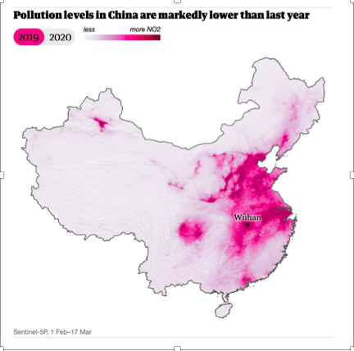
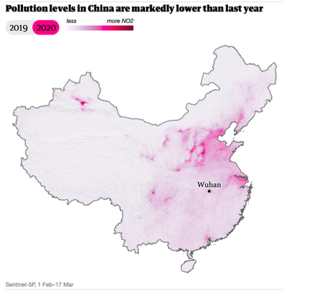
Interpret These Data Sets - What is the Question?
NASA Satellite Images - Air Pollution over China
Data Interpretation Statement:

Slide 3
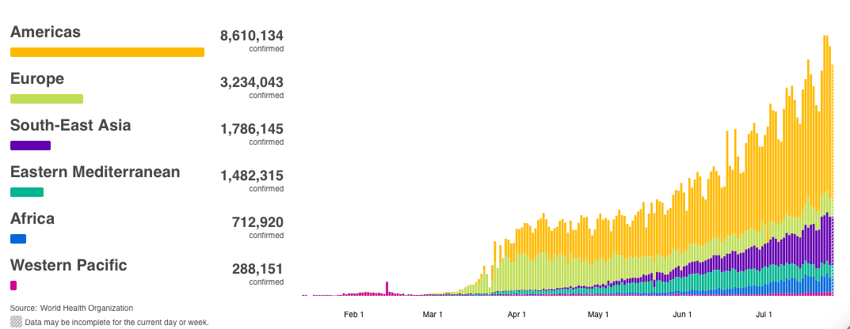
Interpret These Data
- What is the Question?
Source - World Health Organization
Daily COVID-19 cases by region
Data Interpretation Statement:

Slide 4
BREAKOUT ROOM 2
Pick one or more of the data set images and write on the slide what you think the question is that data set images are answering

Slide 5
Interpret These Data Sets - What is the Question?
NASA Satellite Images - Air Pollution over China
Data Interpretation Statement:

Slide 6
Interpret These Data
- What is the Question?
Source - World Health Organization
Daily COVID-19 cases by region
Data Interpretation Statement:

Slide 7
BREAKOUT ROOM 3
Pick one or more of the data set images and write on the slide what you think the question is that data set images are answering

Slide 8
Interpret These Data Sets - What is the Question?
NASA Satellite Images - Air Pollution over China
Data Interpretation Statement:

Slide 9
Interpret These Data
- What is the Question?
Source - World Health Organization
Daily COVID-19 cases by region
Data Interpretation Statement:

Slide 10
BREAKOUT ROOM 4
Pick one or more of the data set images and write on the slide what you think the question is that data set images are answering

Slide 11
Interpret These Data Sets - What is the Question?
NASA Satellite Images - Air Pollution over China
Data Interpretation Statement:

Slide 12
Interpret These Data
- What is the Question?
Source - World Health Organization
Daily COVID-19 cases by region
Data Interpretation Statement:

