Slide 1
BREAKOUT ROOM 1
Place the various graph types inside the graph choice chart: Comparison, Distribution or Composition

Slide 2
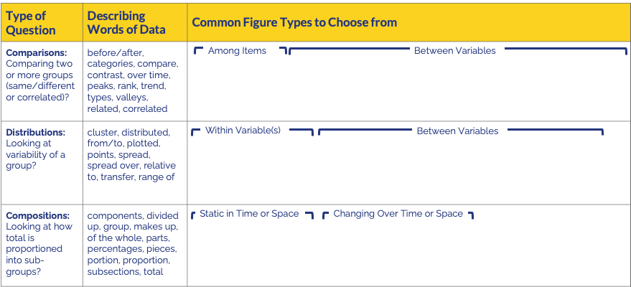
Place these various graph types in the chart below
adapted from (https://dataspire.org/graph-type-matrix-resources)

Slide 3
BREAKOUT ROOM 2
Place the various graph types inside the graph choice chart: Comparison, Distribution or Composition

Slide 4
Place these various graph types in the chart below
adapted from (https://dataspire.org/graph-type-matrix-resources)

Slide 5
BREAKOUT ROOM 3
Place the various graph types inside the graph choice chart: Comparison, Distribution or Composition

Slide 6
Place these various graph types in the chart below
adapted from (https://dataspire.org/graph-type-matrix-resources)

Slide 7
BREAKOUT ROOM 4
Place the various graph types inside the graph choice chart: Comparison, Distribution or Composition

Slide 8
Place these various graph types in the chart below
adapted from (https://dataspire.org/graph-type-matrix-resources)

