Slide 1
BREAKOUT ROOM 1
Pick one or more of the data set images and write on the slide what you think the story are that data set images are telling

Slide 2
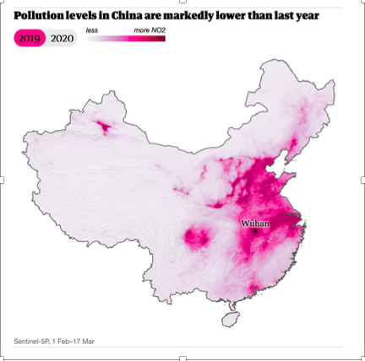
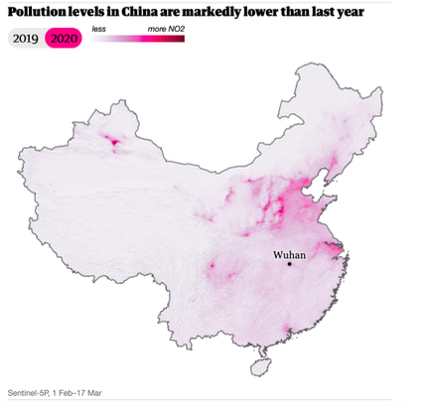
Analyze These Data Sets - What is the Story?
NASA Satellite Images - Air Pollution over China
Data Analysis Statement: pollution levels are lower due to shelter in place; pollution dropped due to no travel;

Slide 3
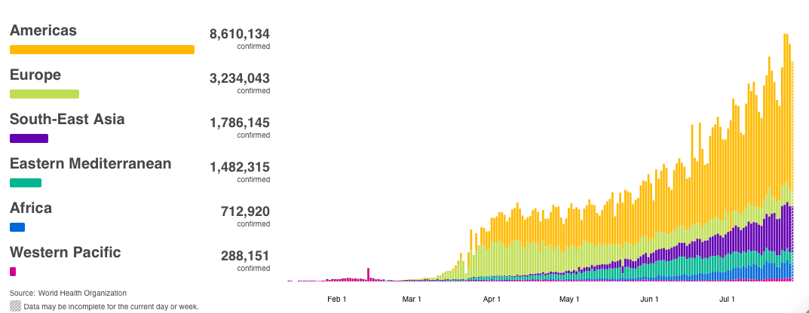
Analyze These Data
- What is the Story?
Source - World Health Organization
Daily COVID-19 cases by region
Data Analysis Statement: increase in cases overall, green area slight decrease; daily cases are increase from x to y; americas are increasing

Slide 4
BREAKOUT ROOM 2
Pick one or more of the data set images and write on the slide what you think the story are that data set images are telling

Slide 5
Analyze These Data Sets - What is the Story?
NASA Satellite Images - Air Pollution over China
Data Analysis Statement:

Slide 6
Analyze These Data
- What is the Story?
Source - World Health Organization
Daily COVID-19 cases by region
Data Analysis Statement:
Bonus Question: What kind of graph is this?

Slide 7
BREAKOUT ROOM 3
Pick one or more of the data set images and write on the slide what you think the story are that data set images are telling

Slide 8
Analyze These Data Sets - What is the Story?
NASA Satellite Images - Air Pollution over China
Data Analysis Statement:

Slide 9
Analyze These Data
- What is the Story?
Source - World Health Organization
Daily COVID-19 cases by region
Data Analysis Statement:
Bonus Question: What kind of graph is this?

Slide 10
BREAKOUT ROOM 4
Pick one or more of the data set images and write on the slide what you think the story are that data set images are telling

Slide 11
Analyze These Data Sets - What is the Story?
NASA Satellite Images - Air Pollution over China
Data Analysis Statement:

Slide 12
Analyze These Data
- What is the Story?
Source - World Health Organization
Daily COVID-19 cases by region
Data Analysis Statement:
Bonus Question: What kind of graph is this?

